Slide 1
Theory of
a quantum spin nematics (QSN)
in a frustrated ferromagnet
Ryuichi Shindou
(Tokyo Institute of Technology)
Reference
R. Shindou & T. Momoi, Phys. Rev. B. 80, 064410 (2009)
R. Shindou, S. Yunoki & T. Momoi, arXiv:1106.5333v1
R. Shindou, S. Yunoki & T. Momoi, preprint (to be posted)

Slide 2
Content
brief introduction on quantum spin liquid (QSL)
---Fractionalization of magnetic excitations
（spinon: spin ½ neutral fermion） ---
Spin-triplet variant of QSL := quantum spin nematics (QSN)
--- `mixed’ Resonating Valence Bond (RVB) state ---
mixed RVB state in a frustrated ferromagnet
Mean-field theory/analysis and gauge theory of QSN
Variational Monte Carlo analysis
--- comparison with exact diagonalization studies ---
Physical/Experimental Characterizations of QSN
--- static/dynamical spin structure factor ---
perspective on QSN
--- new root to the fractionalization of spin ? ---

Slide 3
Chanllenge in Condensed Matter Physics
A new quantum state of matter (i.e. a new form of quantum zero-point motion)
e.g.
Integer/Fractional Quantum Hall state
Topological insulator (quantum spin Hall insulator)
Quantum spin liquid
; a quantum spin state which does not show
any kind of ordering down to T=0.
What is Quantum Spin Liquids ?
Based on Review by
Balents, Nature (2010)
:= resonating valence bond state ; RVB state
PW Anderson (1973)
Ground state of S=1/2 quantum
Heisenberg model on △-lattice ??
`Basic building block’
−
Spin-singlet bond
(favored by Antiferromagnetic
Exchange interaction)
Non-magnetic state (spin-0)

Slide 4
Review by Balents, Nature (2010)
Valence bond solid (VBS) state
Non-magnetic state (spin-0)
every spin ½ is assigned to a specific
valence bond (VB)
-- (essentially) `static‘ configuration of VB --
|w.f.> =
`single product state of singlet bonds’
CaV₂O₅, SrCu₂O₃, SrCu₂(BO₃)₂ , . . .
valence bond `liquid’ state = RVB state
|w.f.> = `quantum-mechanical superposition of various configurations of singlet VB’
+
+ . . . .
No preference for any specific valence bond
➔ translational symemtry is unbroken!
➔ fractionalized magnetic excitation (spinon) and emergent gauge boson

Slide 5
Where are RVB states ?
Quantum Heisenberg model (QHM) on triangle lattice
➔ Coplanar antiferromagnetic state (`120-degree’ state)
Quantum Dimer model
2-d Bipartite-lattice ➔ No stable RVB state
2-d non-bipartite lattice ➔ stable RVB state (Z₂ spin liquid)
3-d Bipartite-lattice ➔ U(1) spin liquid
Moessner-Sondhi (`01)
Huse-Moessner-Sondhi (`04)
Hermele-Balents-Fisher (`04)
Stable gapless gauge boson (`photon’-like)
Kitaev (`06), Balents-Fisher (`02), Motrunich-Senthil (`02) ; exact solvable models
S=1/2 Kagome quantum Heisenberg model , honeycomb Hubbard model, . .

Slide 6
Possible variant of RVB states ??
Chubukov (‘91)
Shannon-Momoi-Sinzingre (’06)
Shindou-Momoi (‘09)
Mixed RVB states consist of singlet
and triplet valence bonds !
Ψ =
+
+
+ . . .
Director vector
spin-triplet valence bond
spin-singlet
X-axis
YZ-plane
An S=1 Ferro-moment is
rotating within a plane.
another maximally entangled state of two spins
Ferromagnetic exchange interaction likes it.
We also needs spin-frustrations, to avoid simple
ferromagnetic ordered state.
Ferro
Anti-ferro
Ferro
➔ `Quantum frustrated ferromagnet’ !

Slide 7
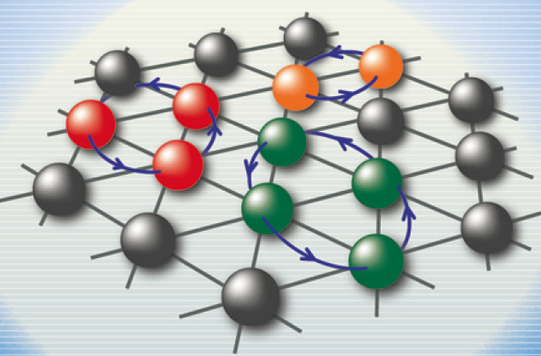
Where is frustrated ferromagnets ?
Mott insulator : (CuCl)LaNb₂O₇ , LiCuVO₄ , . . .
Cu²⁺ = localized spin ½
Chlorine (1-)
Oxygen (2-)
Cu²⁺
Anti-Ferro
(superex.)
Goodenough-Kanamori Rule
Cu²⁺
Nearest-Neighbor (NN) = Ferro J1
Next-Nearest-Neighbor(NNN) = Anti-Ferro J2
Ferro
(direct ex.)
➔ J1-J2 square-lattice Heisenberg model
³He-atom on thin Film of the Solid ³He
³He = Nuclear spin ½
Strong quantum fluctuations of He-atom induces
the ring-exchange process among several He atoms.
3-body ring exchange = ferromagnetic
which competes with other AF ring exchange
interactions, such as 4-body and 2-body ones.
Roger et.al. (`83)

Slide 8
Mean-field theory of mixed RVB state
Projectective description of the spin operator.
Under the local constraint of `single fermion on single site’,
spin operator is given by billinear of fermion (spinon)
for
Fermion bilinear
Local constraint
Lagrange multiplier
= (temporal component of ) gauge field
(temporal) gaugue field
Nambu vector
Nambu “matrix”
Time-reversal pair
(Affleck-Zou-Hsu-Anderson, PRB, 38, 745, (1988))
Spin Operator:
Spin-Rotation:
SU(2) local gauge symmetry:
Affleck etal . `88

Slide 9
exchange interaction ➔ quartic term of fermion field
Ferro-bond → decouple in the spin-triplet space
Shindou-Momoi, (2009)
spin-triplet SU(2) link variable
spin-triplet pairing of spinons
: p-h channel
: p-p channel
AF-bond → decouple in the spin-singlet space (Anderson, Baskaran, Affleck. . . )
spin-singlet SU(2) link variable
spin-singlet pairing of spinons
: p-h channel
: p-p channel

Slide 10
What triplet pairing fields mean . . .
Shindou-Momoi (‘09)
spin-singlet pairing of spinons for antiferromagnetic bonds
: p-h channel
: p-p channel
=
−
Singlet valence bond
spin-triplet pairing of spinons for ferromagnetic bonds
: p-h channel
: p-p channel
S=1 moment is rotating within a
plane perpendicular to the D-vector.
D- vector
=
(side-view of) rotating plane
S=1 moment
rotating-plane

Slide 11
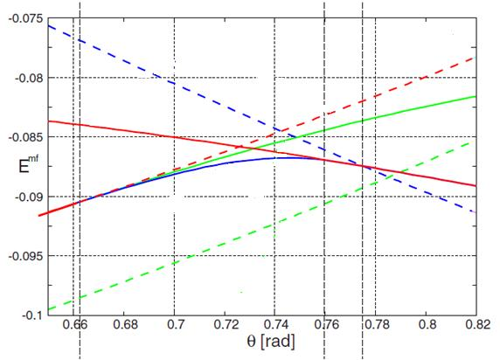
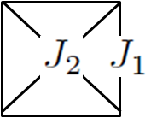
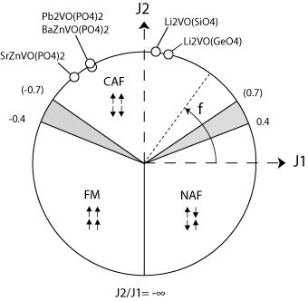
Mean-field analysis on S=1/2 J1-J2 Heisenberg model on the square lattice
In absence of the spin
-triplet pairings on F-bond, . . .
π-flux state on each □-lattice
Planar state
→ Decoupled AF □-lattice
Either π-flux state or isolated dimer
state is stabilized on each □-lattice
Affleck–Marston, (88) , …
Isolated dimer state
on each □- lattice
When local constraint is strictly included,
π-flux state becomes egenergetically
more favourable than isolated
dimer state. Gros (`88)
Based on the π-flux states, spin-triplet pairing develops . .
Singlet pairing on Next Nearest AF-bond
Spinon-analogue
of planar state
p-h channel = s-wave
p-p channel = d-wave
triplet pairing on Nearest F-bond
Coplanar configuration of D-vector

Slide 12
Low-energy excitations around this mixed RVB state
Collective mode (Nambu-Goldstone mode) ⬅ breaking spin rotational symmetry
Suppose that a mean-field theory works, . . .
Individual exicitation of spinon-field (a kind of Stoner continuum)
⬅ determined by the details of the spinon’s energy band
In the presence of spinon Fermi-surface
In the presence of band-gap,
ω
ω
ω
`Spinon continuum’
`Spinon continuum’
k
k
well-defined
Goldstone mode
k
damped
Goldstone mode
Dynamical spin structure factor S(q,ε)
coherent bosonic modes other than NG bosons; emergent gauge bosons
Gapless gauge bosons (often) result in a strong confining potential
b.t.w. a pair of spinon ➔ fermion is no longer a well-defined quasi-particle !
Confinement effect
Polyakov (`77)

Slide 13
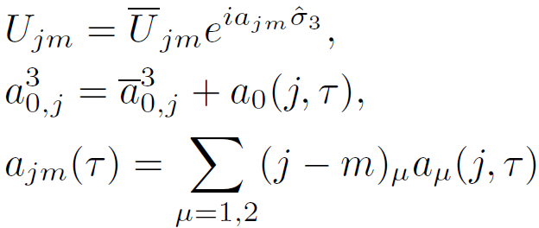
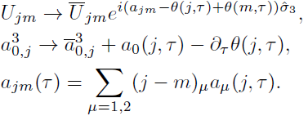
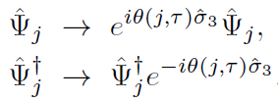
Condition for the exsistence of `Gapless gauge boson’
➔ How the mean-field ansatz breaks the global SU(2) gauge symmetry?
Mean-field Lagrangian
Wen (`91)
global U(1) gauge symmetry around 3-axis
Expansion w.r.t. U(1) gauge-field
for any j, m
Temporal component
of gauge field
for any j
Spatial component
of gauge field
Gauge fluctation around the saddle point solution
deformation by local guage trans.
Notice that is defined modulo 2π, . . .
(2+1)d U(1) lattice gauge theory
Polyakov (77)
Local gauge transformation
Due to the strong confining potential,
two free Spinon are spatially bounded to each other,
only to end up in an original magnon (S=1) excitation
(No-Go for fractionalization of spin・breakdown of MFT)
Quark corresponds to Spinon
(μ=1,2) ：`electric field’
(μ,ν=0,1,2) : Curvature
L
Confining potential between two
Spinon is proportional to their distance R
：`magnetic field’
Read-Sachdev (91)

Slide 14
The planar state breaks all the global gauge symmetries!!
Shindou-Momoi (‘09)
A
B
singlet pairings on a NNN AF-boond
p-h channel = s-wave
p-p channel = d-wave
(Only) global Z₂ gauge symmetry
Global U(1) gauge symmetry
for
B
A
➔ Gauge field at (π,π) gets gapless(`photon’)
➔ All Gauge bosons becomes massive
（Higgs mass）
The mean-field ansatz is stable against `small’
gauge fluctuation (against `confinement’ effect)
Each spinon is supposed to be liberated from its
parter, only to become a well-defined excitation.
➔ Z₂ planar state

Slide 15
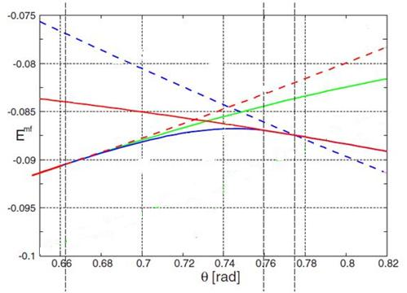
When the ferromagentic interaction fruther increases
Collinear antiferromagnetic
(CAF) state
(with staggered moment)
Z2 planar state
Ferromagnetic state
(only spin-triplet pairing)
π-flux state on each □-lattice
When stagger magnetization is introduced, the energy is further optimized (CAF)
Only spin-triplet pairings
on NN ferro-bonds (`flat-band’ state)
Liang, PRL (88)
(When projected to the spin-Hilbert space)
reduces to a fully polarized ferromagnetic state.
Shindou-Yunoki-Momoi (2011)
Slave-boson Mean-field Theory replace the local constraint by the global one,
so that the BCS w.f. generally ranges over unphysical Hilbert space.
for

Slide 16
Variational Monte Carlo (VMC)
Variational MC ➔ (1) Construct many-body BCS wavefunctions from MF-BdG Hamiltonian.
(2) Project the wavefunctions onto the spin Hilbert space.
BCS wavefunction for `parity-mixed’ SC state
Shindou, Yunoki and
Momoi, arXiv1106.5333
where
and
N:= # (lattice site)
Representation with respect to binary config.
Bouchaud, et.al. (`88),
Bajdich et.al. (`06), . .
where
: N*N anti-symmetric matrix

Slide 17
Quantum spin number projection
Projected BCS w.f. with spin-triplet pairing breaks the spin rotational symmetry.
All the eigen-state (including ground state) of the Heisenberg model
constitute some irreducible representation of this continuous symmetry.
➔ When projected onto an appropriate eigen-space of the spin rotational
symmetry (usually singlet), the optimized energy will be further improved.
Projection onto the spin-Hilbert space
Projection onto the subspace of spin quantum number
where
We usually project onto the subspace of either S=0 or S_{z}=0

Slide 18
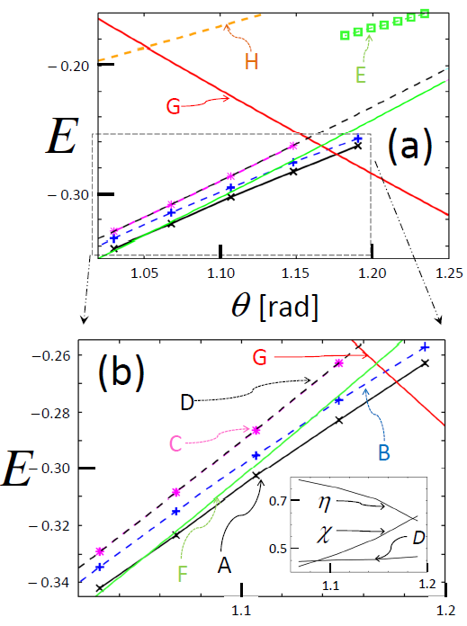
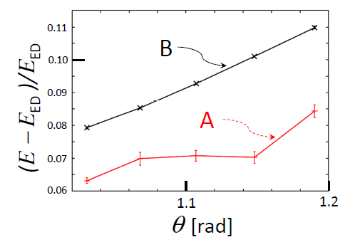
Energetics of projected Z₂ planar state
Shindou, Yunoki and
Momoi, arXiv:1106.5333
A:
B:
For J1:J2=1:0.42 ～ J1:J2=1:0.57,
the projected planar state (singlet)
wins over ferro-state and collinear
antiferromagnetic state.
90%～93% of the exact ground
state with N = 36 sites.

Slide 19
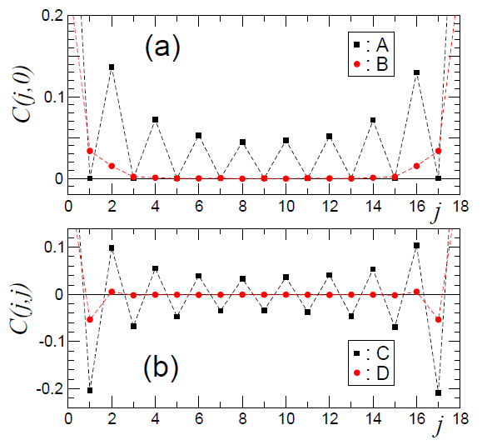
Shindou, Yunoki and
Momoi, arXiv:1106.5333
Spin correlation functions
J2=0.45*J1
A,C
B,D
Fig.(a)
Θ-rot.
−Θ-rot.
Global U(1) symmetry in spin space
Θ-rotation @ z-axis in A-sub.
−Θ-rotation @ z-axis in B-sub.
Fig.(b)
No correlation at all between the
transverse spins in A-sublattice (j)
and those in B-sublattice (m).
Staggered magnetization
is conserved !

Slide 20
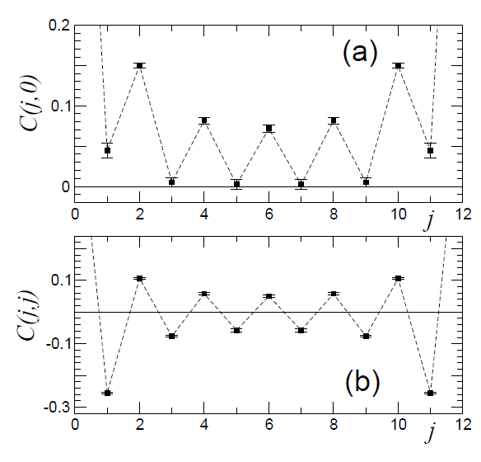
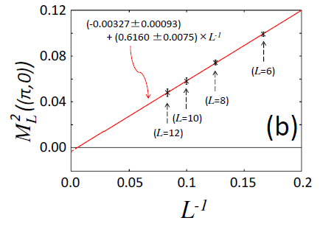
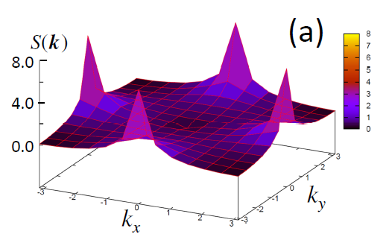
J2=0.45*J1
`Interpolate’ between
C_{zz}(j) and C₊₋(j)
described above
less correlations between spins
in A-sub. and those in B-sub..
Within the same sublattice,
spin is correlated antiferro.
(power law)
η = 0.9 〜 1.0
Prominent collinear antiferromagnetic
Spin correlation at (π,0) and (0,π)
Finite size scaling suggests no
ordering of Neel moment

Slide 21
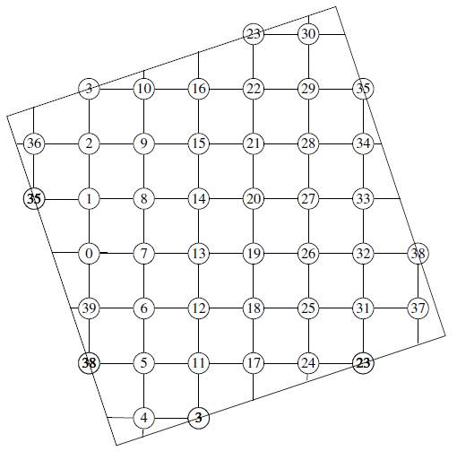
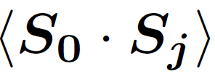
−
+
J2=0.45*J1
From
Richter et.al.
PRB (2010)
−
+
+
−0.00
+0.18
−
−
+0.01
−0.18
−0.00
−0.18
−0.02
−0.30
ED (N = 40)
−0.03
+0.20
−0.02
+0.18
+0.01
+0.20
+0.03
+
−0.30
+0.03
−0.30
−0.03
−0.20
−0.03
−0.30
+0.03
+0.20
+0.01
+0.18
−0.02
+0.20
+0.03
−0.30
−0.02
−0.18
−0.00
−0.18
+0.01
Strong collinear
antiferromagnetic
Correlations.
+0.20
−0.03
+0.18
−0.00
+0.17
−0.00
Correlation fn. of the planar state
is consistent with that of the
Exact Diagonalization results.
−0.20
+0.01

Slide 22
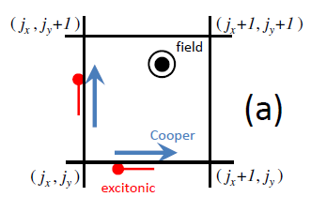
Spin nematic character
Shindou, Yunoki and
Momoi, arXiv:1106.5333
Zero-field case
Projected BCS w.f. is time-reversal symmetric
ordering of the rank-2
tensor of qudaratic
Spin operator without
any spin moment
Under the Zeeman field (along z-direction)
. . . .
S_{z}^{tot} = 6
π-rotation in the spin space around the field
S_{z}^{tot} = 5
S_{z}^{tot} = 4
S_{z}^{tot} = 3
S_{z}^{tot} = 2
S_{z}^{tot} = 1
S_{z}^{tot} = 0
Weight of the projected BCS w.f.

Slide 23
D-wave spin-nematics of Planar state
Shindou, Yunoki and
Momoi, arXiv:1106.5333
π/2-spatial rotation
even
odd
even
odd
π/2-rotation
Around the field
Both in spin-space
and spatial coordinate
field
field
π/2-rotational symmetry in the planar state
Cooper
Cooper
excitonic
a gauge trans.
excitonic

Slide 24
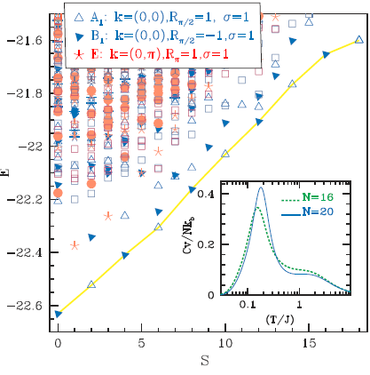
J2=0.4*J1
From
Shannon et.al.
PRL (2006)
ED (N = 36)
D-wave spin nematic
character
Andeson’s tower of state
(Quasi-degenerate Joint state)
c.f.
The projected planar state mimic the
quasi-degenerate joint state
with the same spatial symmetry as that
of the ED study (especially under the field)
odd
even
odd
S=0
S=2
S=4
even
odd
S=6
S=8
Under π/2-spatial rotation

Slide 25
Summary of variational Monte-Carlo studies
Energetics; Projected Z2 planar state ; J₂ = 0.417 J₁ ～0.57 J₁
Spin correlation function; collinear anitferromagnetic fluctuation
(But no long-ranged ordering)
. . . .
π/2-spatial rotation
S_{z}^{tot} = 6
even
S_{z}^{tot} = 5
quadruple spin moment;
d-wave spatial configuration
S_{z}^{tot} = 4
odd
S_{z}^{tot} = 3
S_{z}^{tot} = 2
even
S_{z}^{tot} = 1
Consistent with previous exact
diagonalization studies
S_{z}^{tot} = 0
odd
Weight of the projected BCS w.f.

Slide 26
Physical/Experimental characterization of Z₂ planar phase
Static spin structure takes after that of the
neighboring collinear antiferromagnetic (CAF) phase
Z₂
Planar
phase
CAF
Ferro
J₂
0.57 J₁
0.417 J₁
➔ How to distinguish the Z2 planar phase from the CAF phase ?
Dynamical spin structure factor
(low) Temperature dependence of NMR 1/T₁
➔ Use Large-N loop expansion usually employed in QSL
See e.g. the textbook by Assa Auerbach.

Slide 27
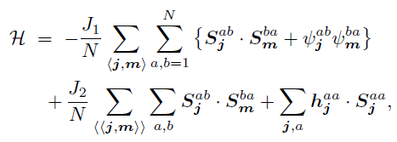
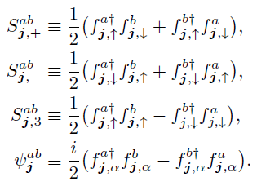
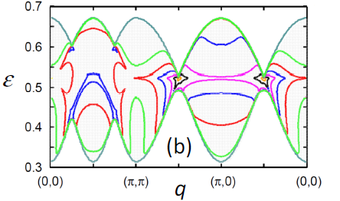
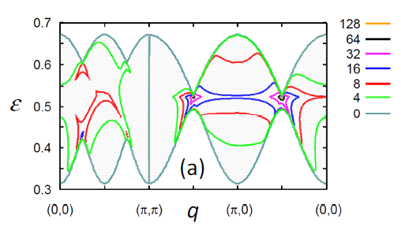
Dyanmical structure factor S(k,ω)
General-N frustrated ferromagnetic model
ε
`Spinon continuum’
?
Magnetic
Goldstone mode
q
SP(2N) spin operator
Large N limit
➔ saddle point solution becomes exact.
1/N correction
fluctuations around the saddle point
are included within the RPA level.
S₊₋(q,ε)
S_{zz}(q,ε)
Large N limit
(Stoner continuum)
h^{aa}
h^{aa}
Spinon’s
propagator

Slide 28
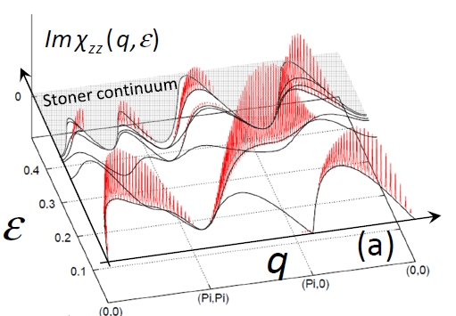
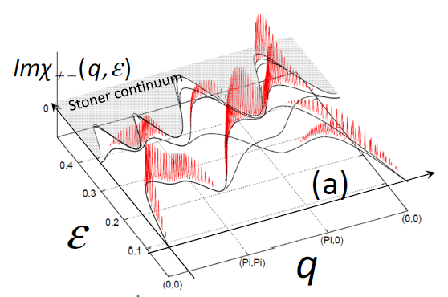
1/N correction
L(ongitudinal)-modes
fluctuation fields
T(ransverse)-modes
RPA propagator
Shindou, Yunoki and
Momoi, to be posted
=
+
+ . . .
We includes all kinds of pairing fields as the fluctuation fields around MF.
Pole of the propagator describes the energy-spectrum of the low-energy
collective modes
Spectral weight at (0,0) vanishes
as a linear function of the momentum.
(a)
(a)
(b)
gives coherent low-energy
bosonic excitations
below the Stoner continuum
A gapless Goldstone mode at (0,π) and
(π,0) does not have a spectral weight
c.f. CAF phase
(c)
Self-energy
corrections
A gapped longitudinal mode at (π,π)
correpsonds to the Higgs boson
associated with the Z₂ state.
(b,c,d)
(d)
Vertex
correction
basically modify the shape and
Intensity of Stoner continuum

Slide 29
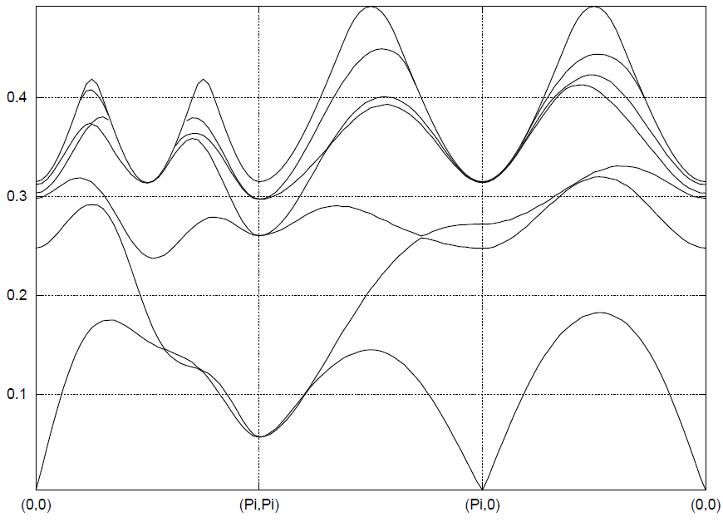
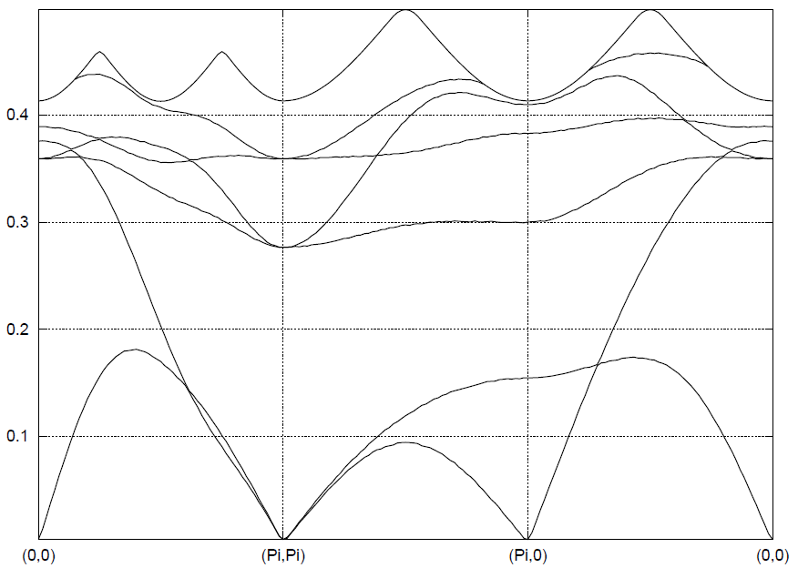
Energy spectra of `L-modes’
Shindou, Yunoki and
Momoi, to be posted
0.5
Stoner continuum
Mean-field Phase diagram
0.4
ε
0.3
0.2
The dispersion at (π,π)
Is kept linear for J₂ < J_{c,2}.
0.1
We are here.
(0,0)
(Pi,Pi)
q
(Pi,0)
(0,0)
(0,0)
(Pi , Pi)
(Pi,0)
(0,0)
The linearity is `protected’ by the local gauge symmetry.
A
B
singlet pairings on a NNN AF-bond
p-h channel = s-wave
p-p channel = d-wave
Global U(1) gauge symmetry
B
A
A certain gauge boson at (π,π)
should become gapless (`photon’-like)

Slide 30
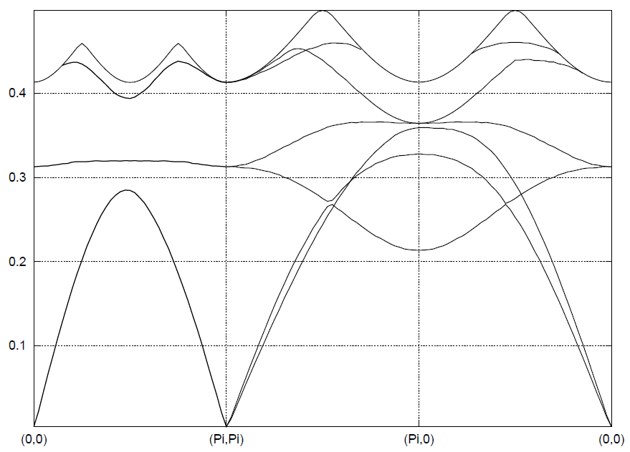
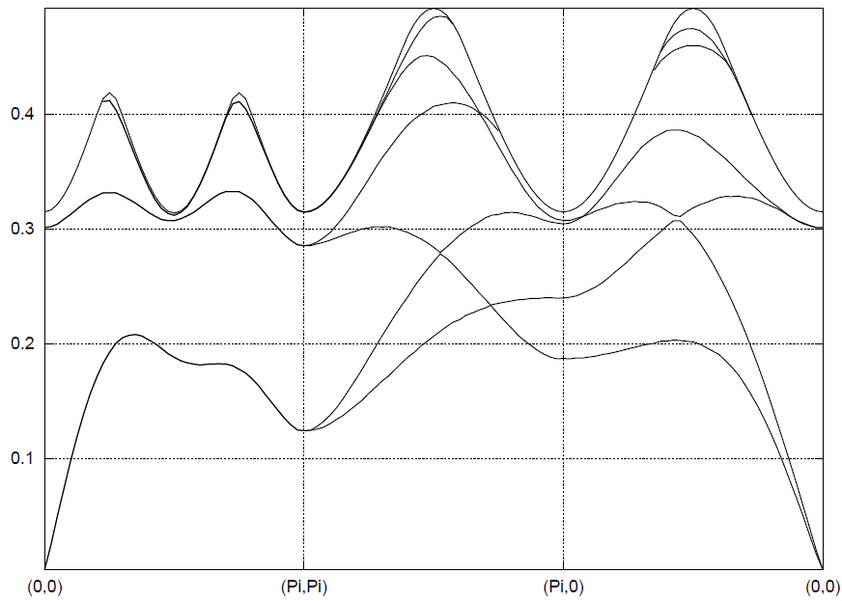
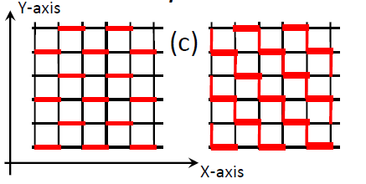
Energy spectra of `T-modes’
Shindou, Yunoki and
Momoi, to be posted
0.5
Stoner continuum
Mass of two other gapped T-modes vanish.
0.4
0.3
➔ Bose-Einstein condensation.
ε
Nature of U(1) planar state
0.2
# Staggered magnetization becomes
no longer Conserved.
0.1
J₂ = J_{c2}
J₂ < J_{c2}
J₂ > J_{c2}
# Translational symmetry is broken.
(0,0)
(Pi,Pi)
(Pi,0)
(0,0)
(0,0)
(Pi , Pi)
(Pi,0)
(0,0)
Condensation of z-component
of the spin-triplet D-vector breaks
the global spin-rotational symmetry
at (π,π).
➔ Consistent wit the `confinement effect’
postulated in the U(1) planar phase.

Slide 31
Summary of dynamical spin structure factor
Shindou, Yunoki and
Momoi, to be posted
No weight at (π,0) and (0,π);
distinct from that of S(q,ε) in CAF phase
Vanishing weight at (0,0); linear function in q
A finite mass of the (first) gapped L-mode at (π,π) describes
the stability of Z₂ planar state against the confinement effect.
Gapped stoner continuum at the high energy region.
Temperature dependence of NMR 1/T₁
Shindou and Momoi in progress
Relevant process to 1/T₁ := Raman process
Nuclear
spin
Moriya (1956)
The present large-N formulation requires
us to calculate the two-loop contribution
to the dynamical spin structure factor
absorption
of magnon
emission
of magnon

Slide 32
Perspective in quantum spin nematic (QSN) phase/states
(I hope) that QSN is a new `root’ to
“fractionalization of spin and emergent gauge fields”
c.f. quantum spin liquid (QSL)
Why stabilized energetically ?
A g.s. wavefuction has less node in general.
Since part of the singlet valence bonds in QSL are replaced
by the triplet valence bond, many-body w.f. of QSN are
generally expected to have less `node’ than those of QSLs.
penalty in QSN ?
In QSLs, any kinds of spin densities are always conserved,
so that the meaning of the `fractionalization’ is clear.
In QSNs, however, not all kinds of spin densities are conserved,
so that the meaning of the `fractionalization’ are sometimes
not so obvious.
E.g.
In the Z₂ planar state, staggered magnetization perpendicular to
the coplanar plane of the D-vectors is the only conserved quantity.

Slide 33
Summary
Spin-triplet variant of QSL := QSN
--- `mixed’ Resonating Valence Bond (RVB) state ---
mixed RVB state in a frustrated ferromagnet
Mean-field and gauge theory of QSN
Variational Monte Carlo analysis
--- comparison with exact diagonalization studies ---
Physical/Experimental Characterizations of QSN
--- dynamical spin structure factor ---
Thank you for your attention !

Slide 34
backup

Slide 35
Fully polarized state out of projected `flat-band’ state
where
Orthogonality condition in the spin space
Generic feature
Under an infinitesimally small Zeeman field, it is energetically
favourable that d-vectors are parallel to the field.
To make this compatible with the orthogonality condition
in the spin space, Θ is going to be energetically locked to be
Integer modulo π/2
e.g.
Θ=0,π
➔ n₁ and n₂ are in the plane perpendicular to the Zeeman field.
For each 1-dim chain, the mean-field w.f. reduces exactly
to a ferromagnetic state, when projected onto the physical spin space.

Slide 36
Summary
Spin-triplet variant of QSL := QSN
--- `mixed’ Resonating Valence Bond (RVB) state ---
mixed RVB state in a frustrated ferromagnet
Mean-field and gauge theory of QSN
Variational Monte Carlo analysis
--- comparison with exact diagonalization studies ---
Physical/Experimental Characterizations of QSN
--- dynamical spin structure factor ---
Thank you for your attention !

Slide 37
“fractionalized” spin exictation
: = Spinon
Review by Balents, Nature (2010)
half of magnon excitation (S=1) (charge neutral excitation with spin ½ )
Magnon (triplon) excitation (S= 1) is decomposed into domain-wall like excitation.
A pair of spinon are created out of 1-Magnon
Whether can we separate a pair of two spinons from each other ??
In VBS state , . . . . Impossible !
L
Energy cost is proportional to L (length between the two).
Two domain-wall excitations are confined with each other (confinement)
Only the original magnon (triplon) is well-defined excitation.

