Slide 1
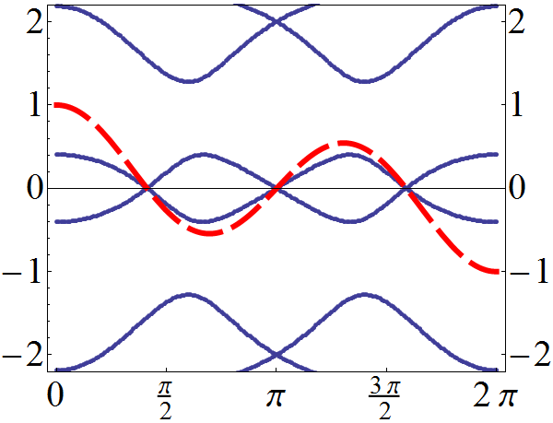
Robustness of Majorana induced Fractional Josephson Effect
Kam Tuen Law HKUST
July 9, 2011 QC11

Slide 2
Outline
Majorana Fermions
-Properties
-In condensed matter systems
-Probing Majorana fermions
Fractional Josephson Effect
Single Channel Case
Multi-Channel Case
Chiral Topological Superconductors

Slide 3
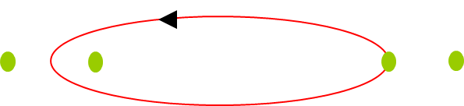
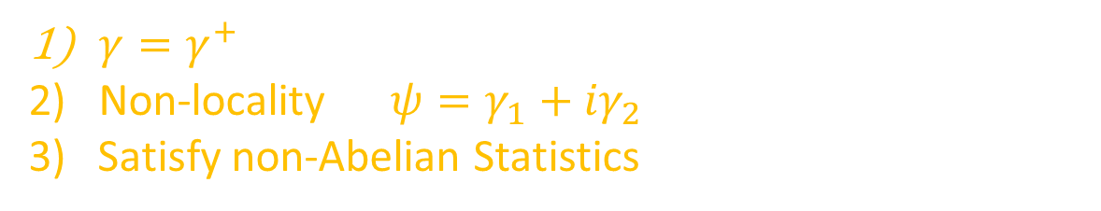
Properties of Majorana Fermions
$γ=γ^{+}$
Non-locality $ψ=γ_{1}+{iγ}_{2}$
3) Satisfy non-Abelian Statistics
Abelian Statistics
Non-Abelian Statistics
1
0
0
1
D. Ivanov PRL (2001)

Slide 4
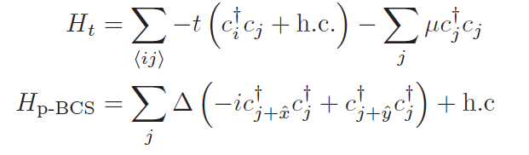



Properties of Majorana Fermions
$${Sr}_{2}RuO_{4}$$
Read,Green PRB 2000
$$γ_{2}$$
$$γ_{1}$$

Slide 5
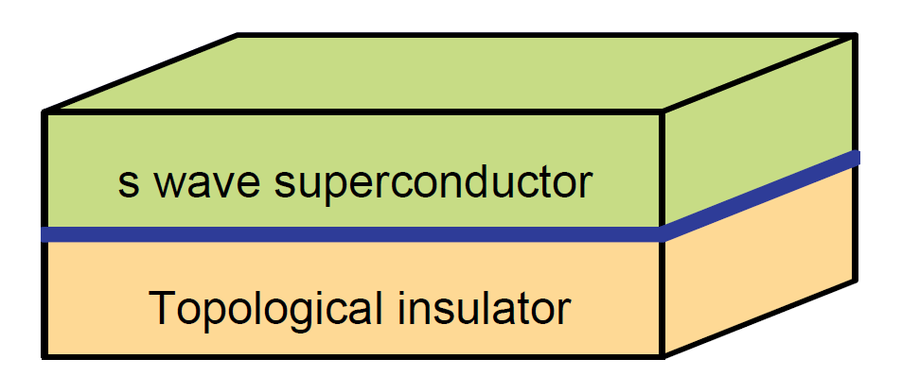

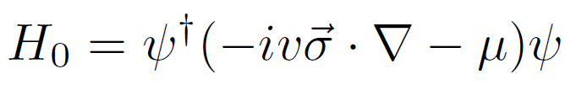



Topological Insulator and Majorana Fermions
How to create Majarana Fermions on topological insulator surface?
By proximity effect induced by a superconductor
Vortex hosts Majorana Fermion
Fu, Kane PRL 2008

Slide 6
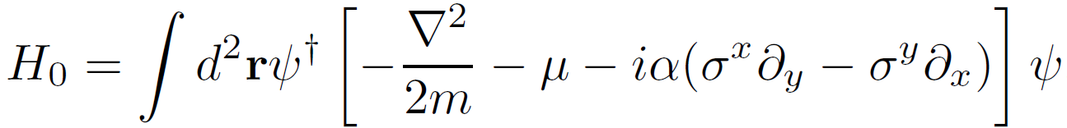
Spin-Orbit Coupled Semiconductors
Alicea PRB 2010

Slide 7
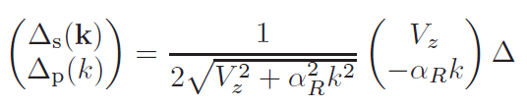
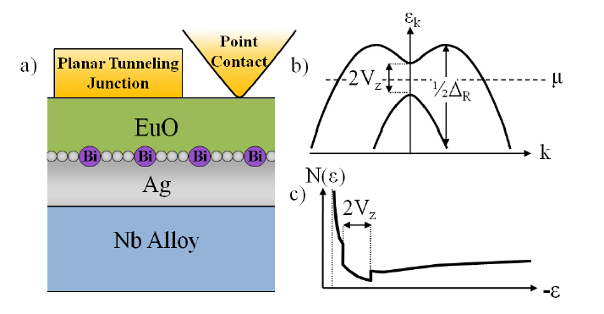
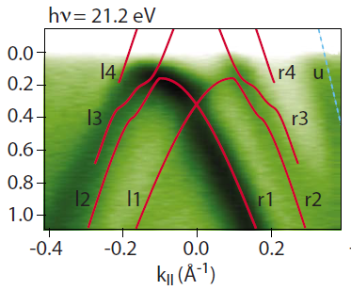
Spin-Orbit Coupled Semiconductors

Slide 8
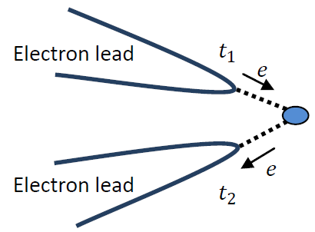

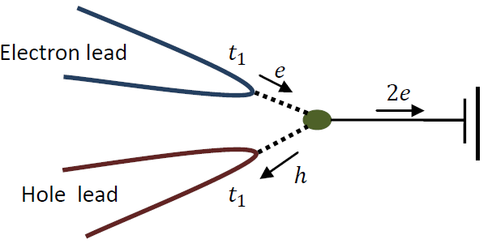
Majorana Fermion Induced Resonant Andreev Reflection

Slide 9
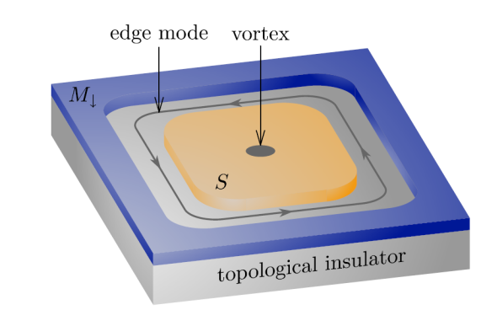


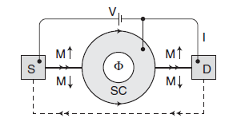
Majorana Fermions at SC/TI interface
TI
SC
M
Charge Transport Through Neutral Mode
Fu, Kane PRL 2009
Akhmerov , etc. PRL 2009

Slide 10
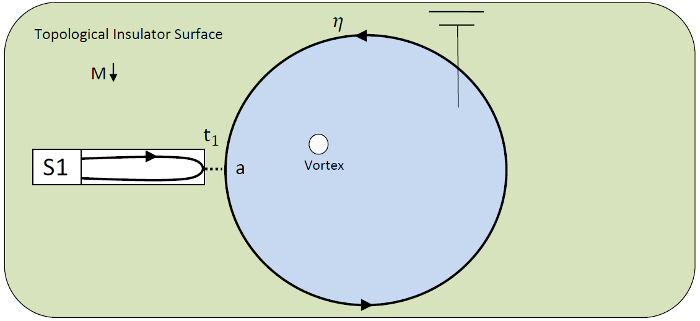
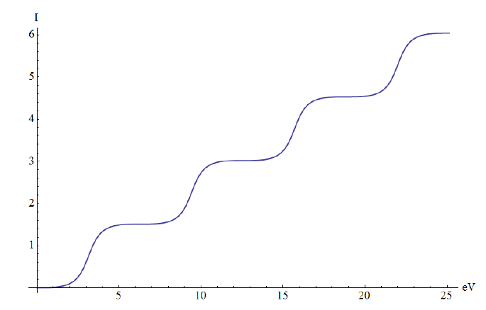
Resonant Andreev Reflection
Andreev Reflection
e
h
2e
NM Lead
Sc
Even number of flux Quantum
Odd number of flux Quantum
KTL, Lee, Ng PRL 2009

Slide 11
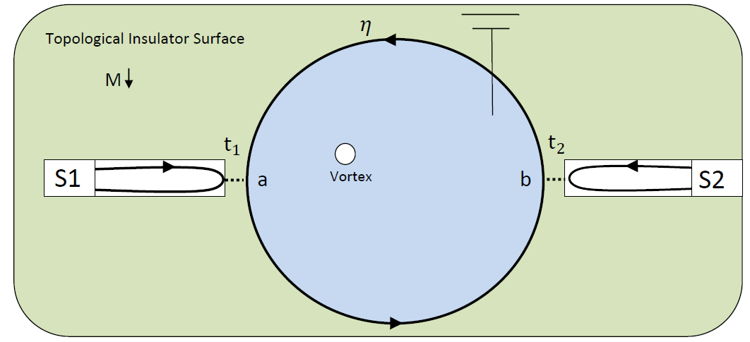

Resonant Andreev Reflection
Cross Andreev
reflection
electron
Superconductor
hole
Even number of vortices
Local Andreev
reflection
Cross Andreev
reflection

Slide 12
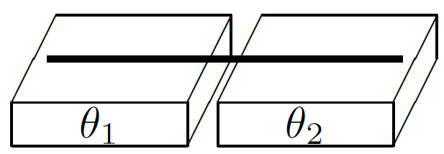






Fractional Josephson Effect 1
$$φ=0$$
$$φ$$
E
E
$$φ$$
$$φ$$
Kitaev 2000
Kwon etc. 2004

Slide 13
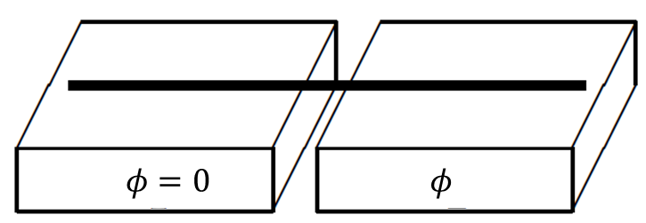


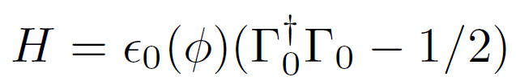
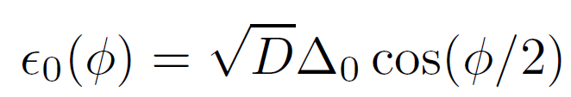
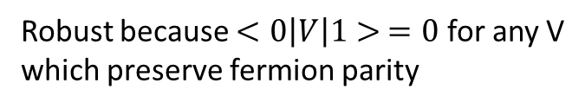





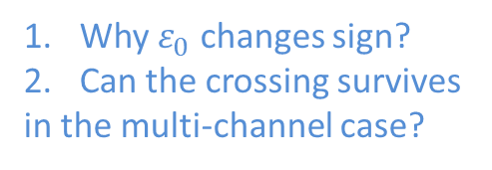
Fractional Josephson Effect 2
$$γ_{1}$$
$$γ_{2}$$
E
$$|1>$$
Why $ε_{0}$ changes sign?
Can the crossing survives
in the multi-channel case?
$$|0>$$
$$φ$$
Robust because $<0\left|V\right|1> =0$ for any V
which preserve fermion parity

Slide 14
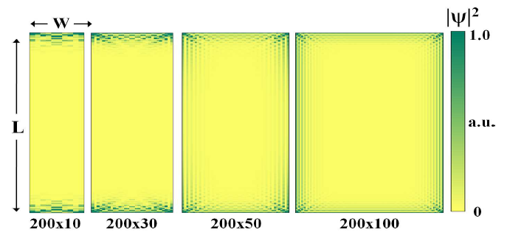
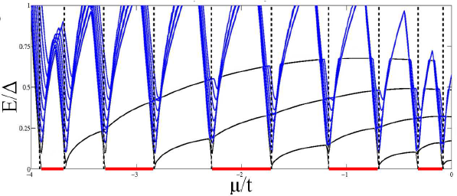
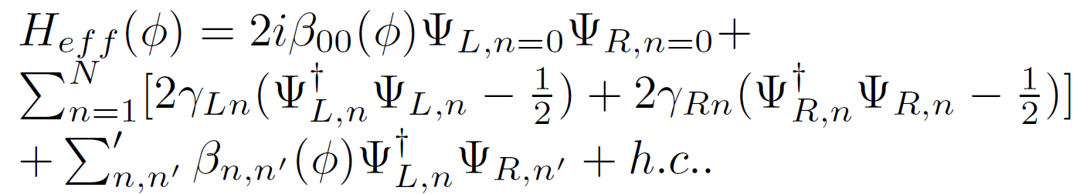
Fractional Josephson Effect 3
Potter, Lee PRL 2010
KTL,LEE Arxiv:1103.5013

Slide 15









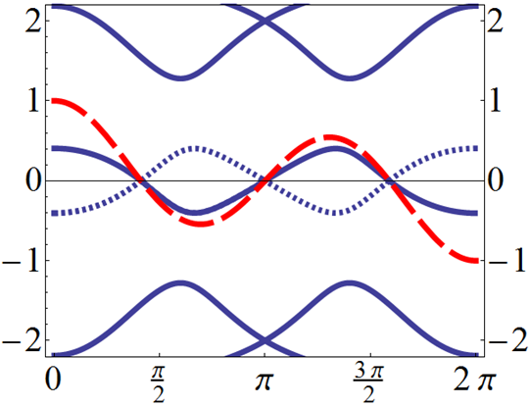







Fractional Josephson Effect 4
Change $φ$ by 2$π$

Slide 16
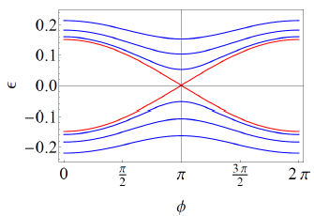


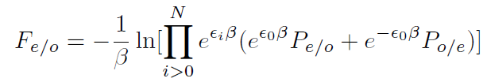



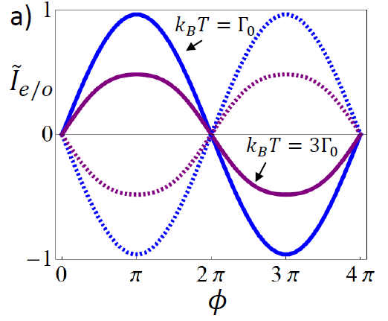

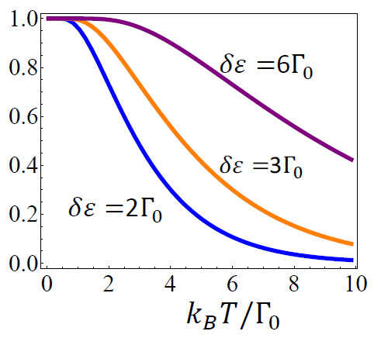





Fractional Josephson Effect 5

Slide 17
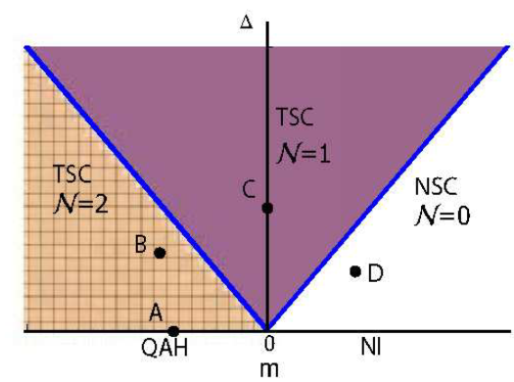
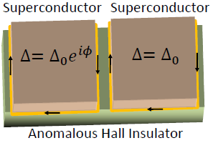



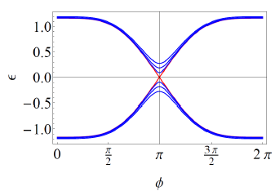
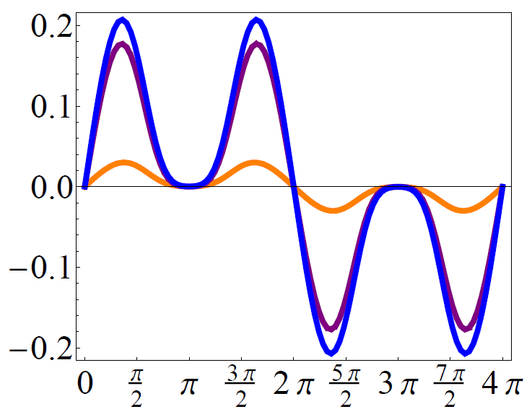
Fractional Josephson Effect 6
To be published KLT, LEE

Slide 18
Conclusion
1.Fractional Josephson effect is robust in the multi-channel case
2.It survives also at finite temperatures
3.It can be used to probe the fermion parity of the Josephson current
4. FJE is immune to disorder in the chiral superconductor case
5.Current phase relation in the chiral superconductor case
shows distinctive features
Thank you

